Slide 1
PHARMACOVIGILANCE ADVERSE DRUG REACTION
BY
DR.G.AARTHIPRIYANKA
POST GRADUATE
DEPARTMENT OF PHARMACOLOGY

Slide 2
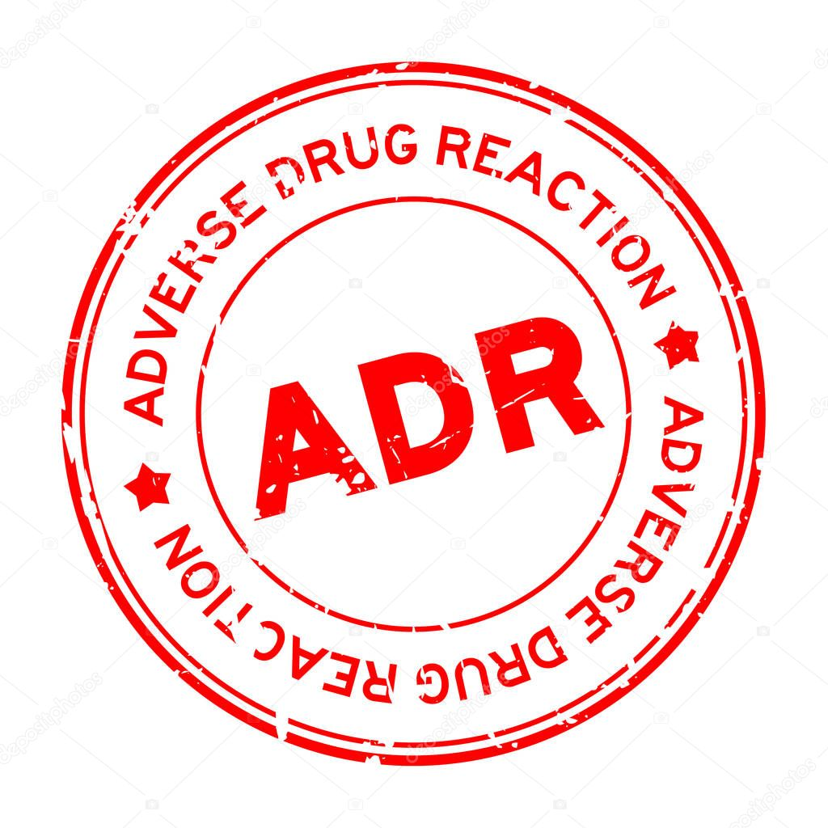
ADVERSE DRUG REACTIONS
Any noxious, unintended and undesired effect of a drug which occurs at a dose used in humans for prophylaxis or modification of physiological functions

Slide 3
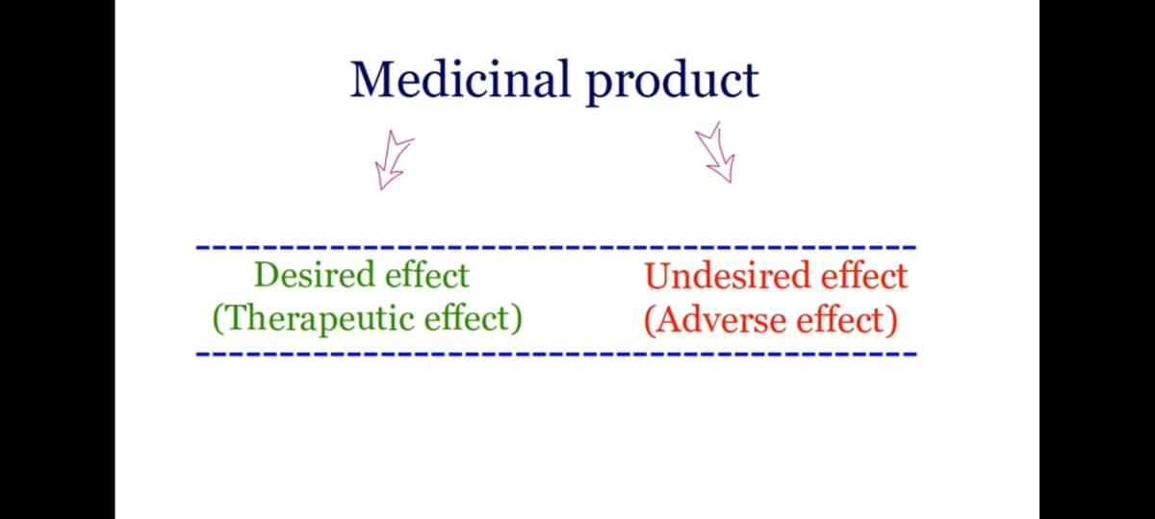

Slide 4
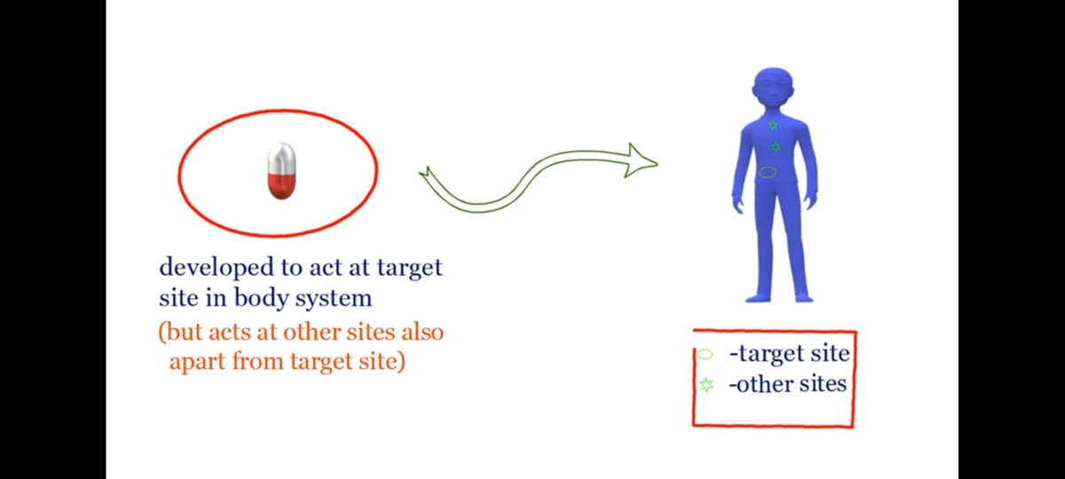

Slide 5
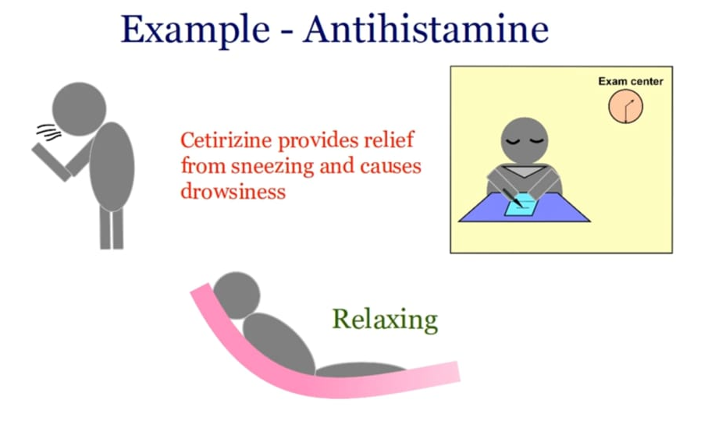

Slide 6
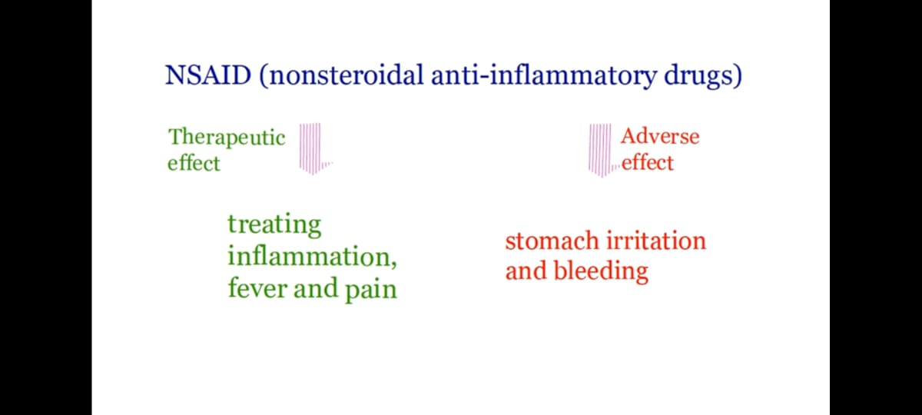

Slide 7
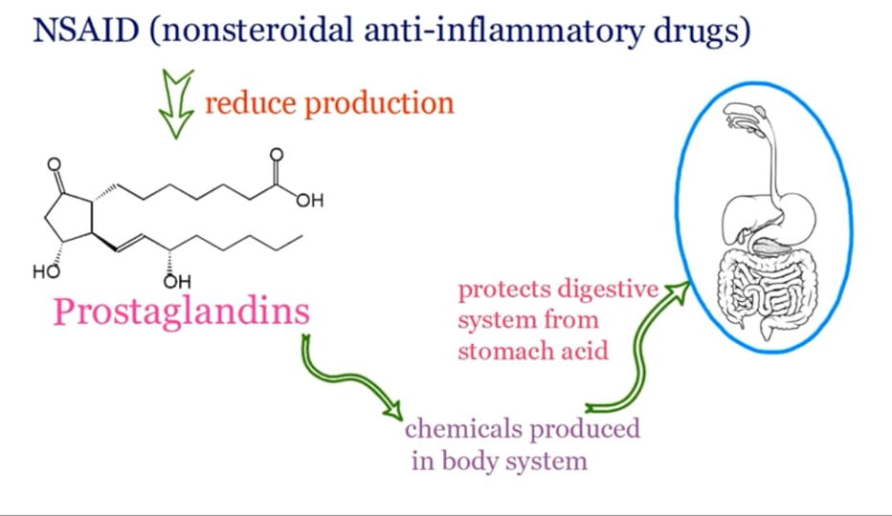

Slide 8
Onset of ADR
Acute : <60 min
Sub-Acute : 1 to 24 hrs
Delayed/Chronic : >2 days

Slide 9
Severity of ADR
Mild : Doesn’t require therapy/Antidote/Hospitalisation
Moderate : Requires change in drug therapy/specific treatment/prolong the hospital stay by at least one day
Severe : Potentially life threatening/permanent damage/requires intensive medical treatment/prolonged hospitalisation/teratogenic
Lethal : Directly or indirectly contributes to death

Slide 10
SEVERE ADVERSE REACTIONS
Life threatening event or death
Hospitalization/prolonged hospitalization
Congenital anomaly
Medically significant event (Disability – Significant/persistent/permanent)

Slide 11
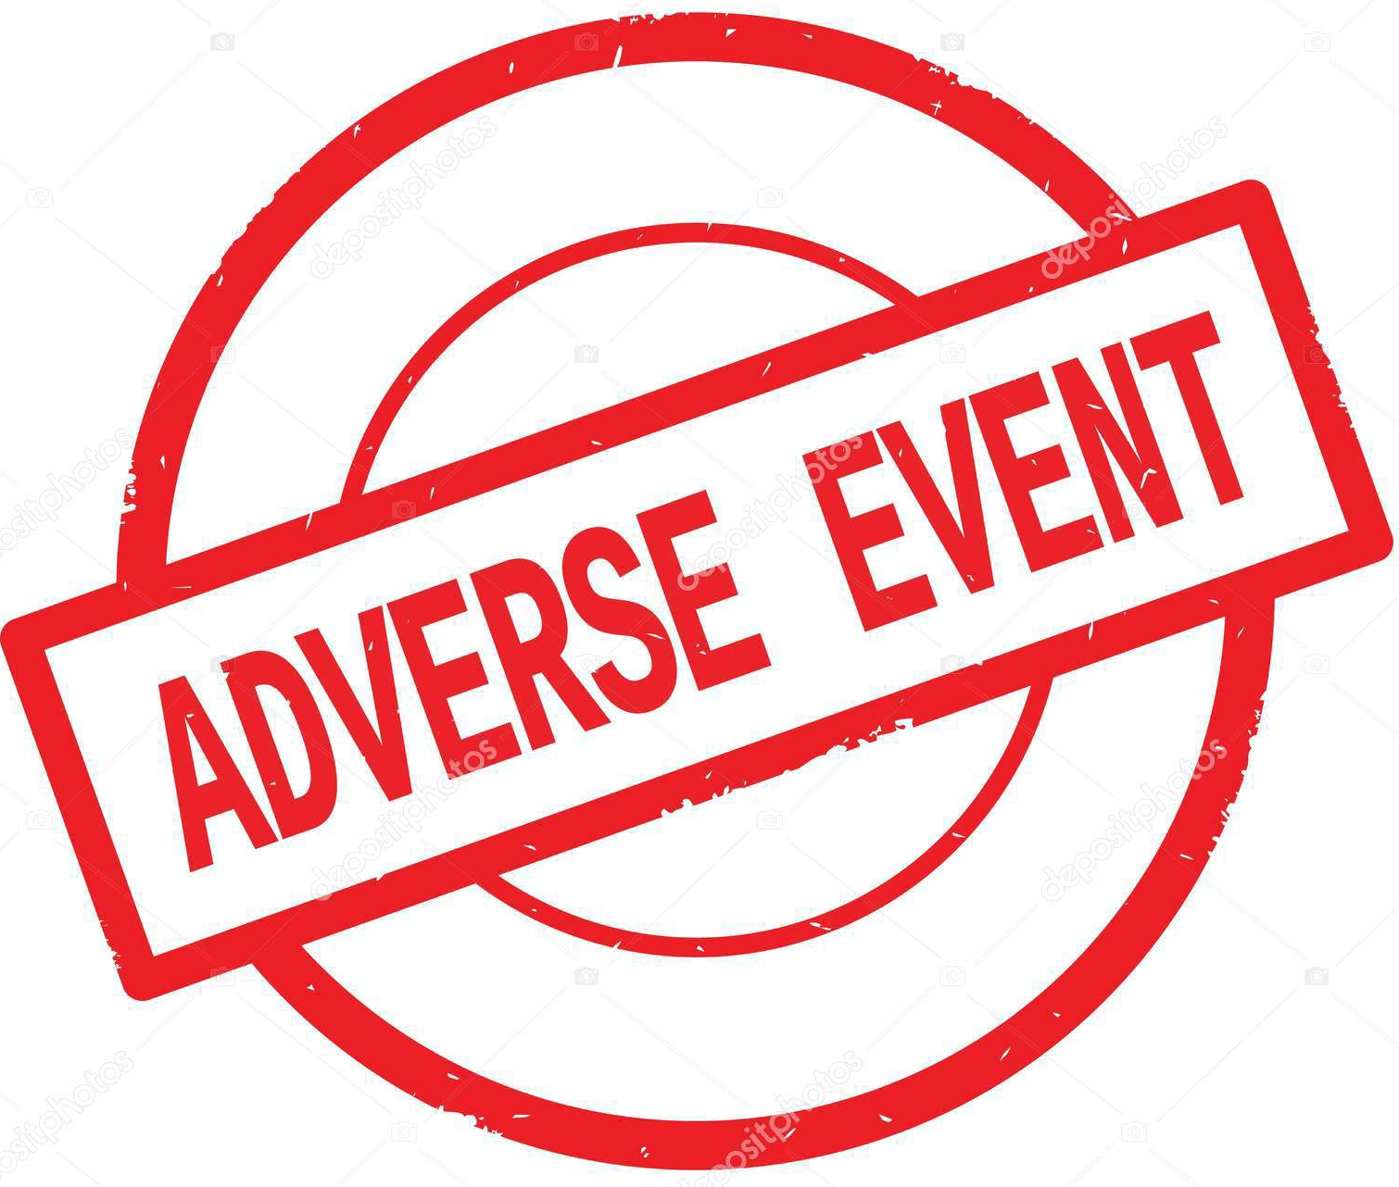
ADVERSE EVENT
Any untoward medical occurrence that may present during the treatment with a pharmaceutical product but which does not necessarily have a casual relationship with the treatment

Slide 12
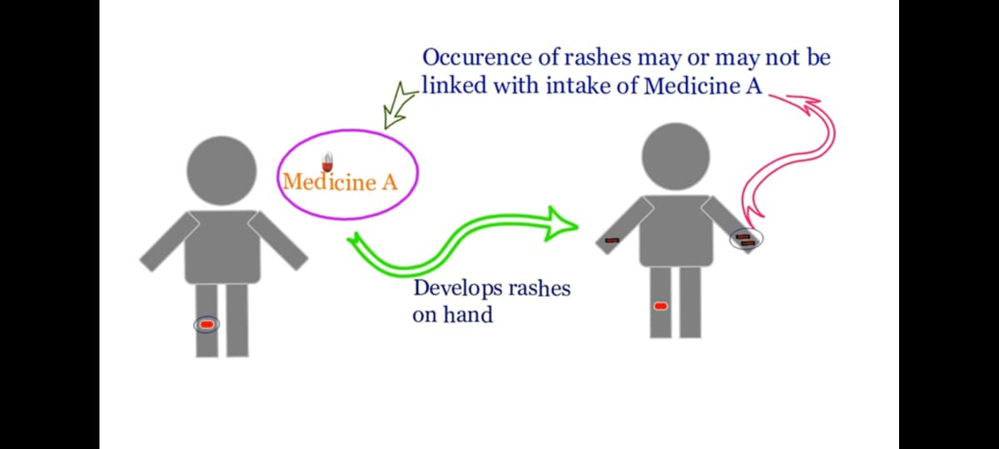
ADVERSE EVENT

Slide 13
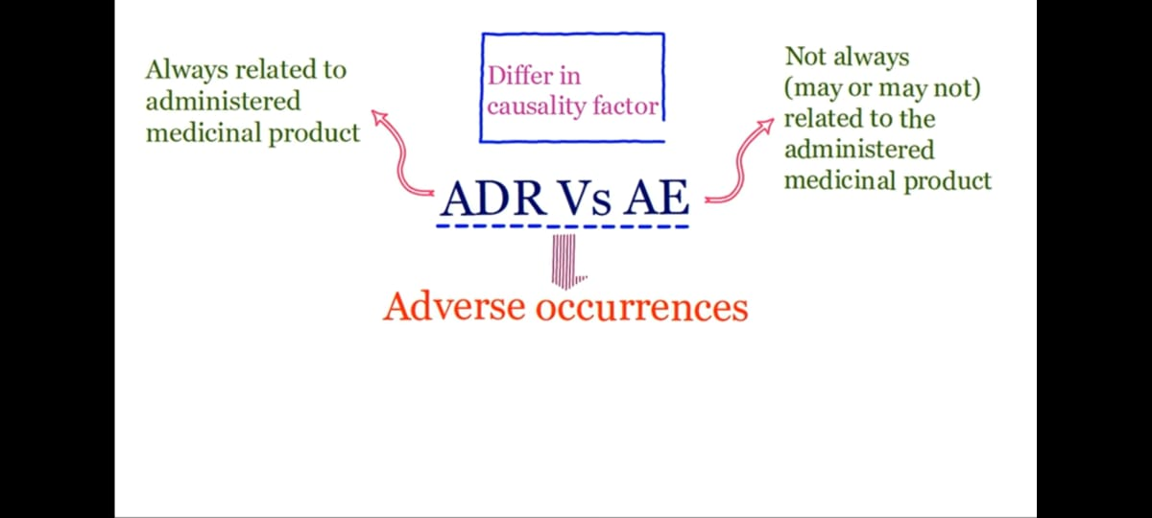

Slide 14
EXPECTEDNESS OF ADR
All ADRs whose nature, specificity or outcome is not consistent with description used in the appropriate reference safety information or investigator’s brochure should be considered unexpected
All ADRs that are previously observed & documented are referred to as expected ADRs.

Slide 15
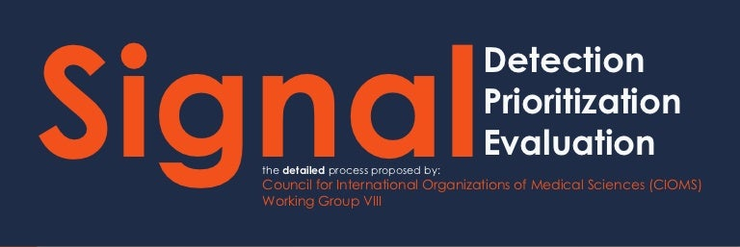
SIGNAL
Reported information on a possible causal relationship between an adverse event and a drug, the relationship being unknown or incompletely documented previously
EXAMPLE:
New unlabelled adverse event or drug- drug interaction
Increase in severity, Specificity or frequency of a labelled event
New Information related to precautions, C/I, Pregnancy, Overdose
Potential Risk a/c specific population such as Age groups, Disease states (Hepatic, Renal, Immunocompromised)

Slide 16
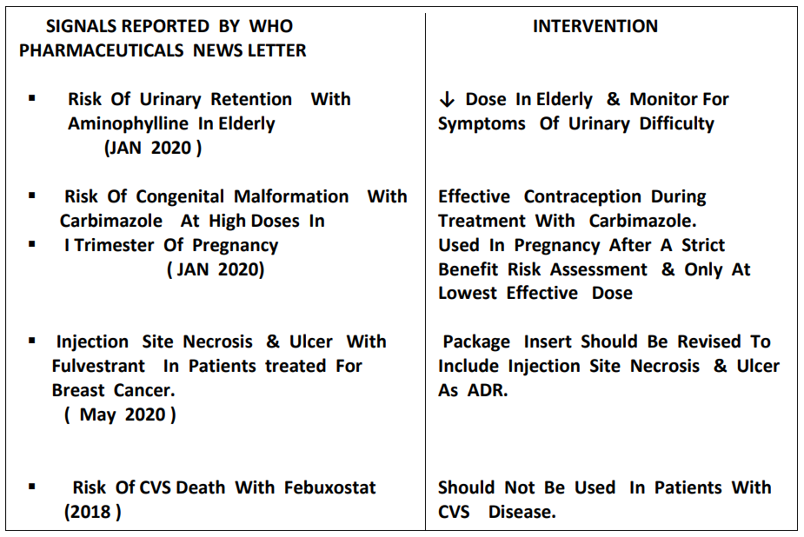

Slide 17

CAUSALITY ASSESSMENT
A major component or the evaluation of reports of suspected ADR is making judgement about the degree to which any reported AE is causally related with suspected drug.
Methods of causality assessment:
Global introspection by WHO-UMC Method
Structured algorithms, with/without scoring:
Naranjo’s scale, Kramer's method, Venulets method, French method & RUCAM score
3. Bayeslans probabilistic methods

Slide 18
FACTORS THAT DETERMINE CAUSAL RELATIONSHIP
1.TEMPORAL RELATIONSHIP:
Time relationship between starting the treatment & onset of the event. A strong causal relationship is supported when onset of ADR coincides with expected peak tissue concentration.
2.PLAUSIBILITY:
ADR is analysed based on mechanism of action or similar previous reports.

Slide 19
3. CLINICAL & PATHOLOGICAL CHARACTERISTIC OF THE EVENT:
The ADR is analysed clinically & on definite pathophysiological mechanisms e.g., Drug induced haemolytic anaemia should be accompanied with raised bilirubin & reduced hb.
4.ALTERNATIVE CAUSES
concomitant diseases, medications or non-drug exposure should be checked
5.RESPONSE TO STOPPING/DOSE REDUCTION (DECHALLENGE)
Recovery after stopping or dose reduction is plausible pharmacologically & pathologically
6.RESPONSE TO DOSE INCREASE (RECHALLENGE)
Occurrence of ADR rechallenge is a strong indicator of causality

Slide 20
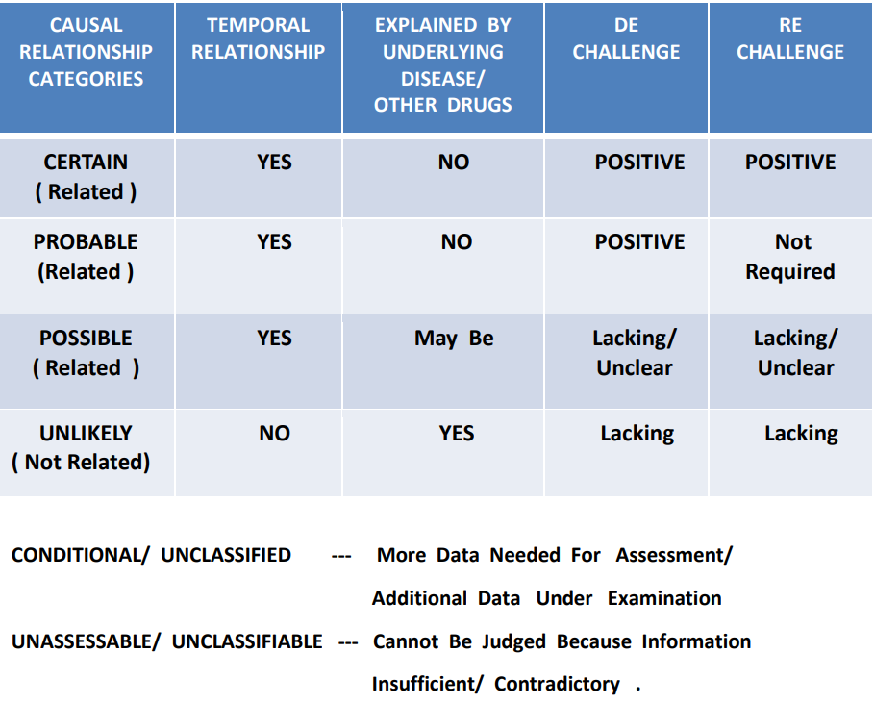
WHO-UMC CAUSALITY CATEGORIES

Slide 21
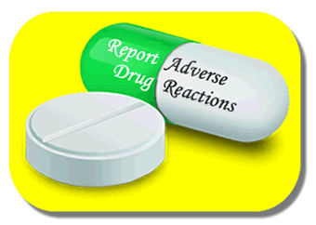
STEPS OF REPORTING
WHO CAN REPORT?
Professionals working in healthcare team are the preferred source of information in Pharmacovigilance,
For example:
Medical specialists
Pharmacists
Dentists
Midwives
Along with HCPs patient, patient’s relatives, witness or any common person after medical confirmation can report
Pharmaceutical industries

Slide 22
WHAT TO REPORT
All types of suspected ADRs whether known/unknown, serious/nonserious, Frequent/rare regardless of an established causal relationship between a drug & reaction
Lack of efficacy/resistance connected with the use of a medical device or drug product
All suspected drug interactions

Slide 23
WHEN TO REPORT
All spontaneous case should be reported within 10 days
All suspected ADR should be reported as soon as possible because over reporting is always better than under reporting
Death event must be reported as soon as possible, while all other serious ADR/event needs to report within 7 days only
All nonserious cases must be reported within 30 days
REPORTING DELAY MAY CREATE SERIOUS PROBLEM

Slide 24
HOW & WHERE TO REPORT
ADR forms for HCP & patients/ consumers are available on the website of IPC. The consumer reporting forms are available in 10 vernacular languages
Daily filled ADR forms can be sent to the nearest AMC or directly to NCC
Call on helpline toll free no 18001803024 on week days from 9am to 5.30pm to report ADR
Can directly mail this filled form to
pvpi@ipcindia.net OR pvpi.ipcindia@gmail.com
Through ADR reporting android app “ADR Pvpi”
A list of AMC is available at
http://www.ipc.gov.in
http://www.ipc.gov.in/pvpi/pv_home.html

Slide 25
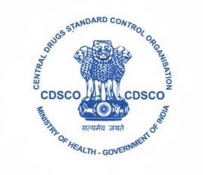
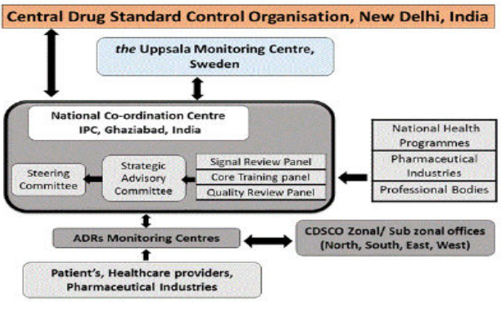
WHAT HAPPENS TO SUBMITTED INFORMATION

Slide 26
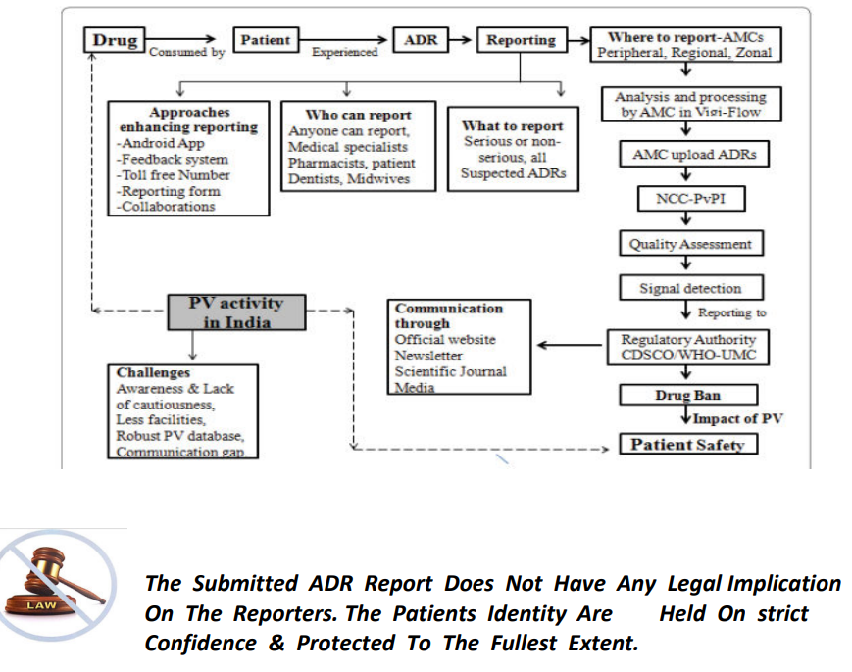

Slide 27
ADR REPORTING FORM
Also called as ADR/case report form/individual case safety report form.
As per WHO the form should have 4 sections
A.Patient information:
Name, age, gender, weight
B.Details of suspected ADR:
Description of problem, date of event & report, seriousness of the reaction, relavant tests/lab data, relavant history & premedical conditions, outcome of the adverse event.

Slide 28
C.Details of suspected medication:
Name of drug (brand name),batch no,expiry date,dose,frequency,route,therapy date & duration,dechallenge,rechallenge,diagnosis for use,concomitant medical products & date of therapy
D.Reporter details:
Name,address,tele.no,email,occupation,signature

Slide 29
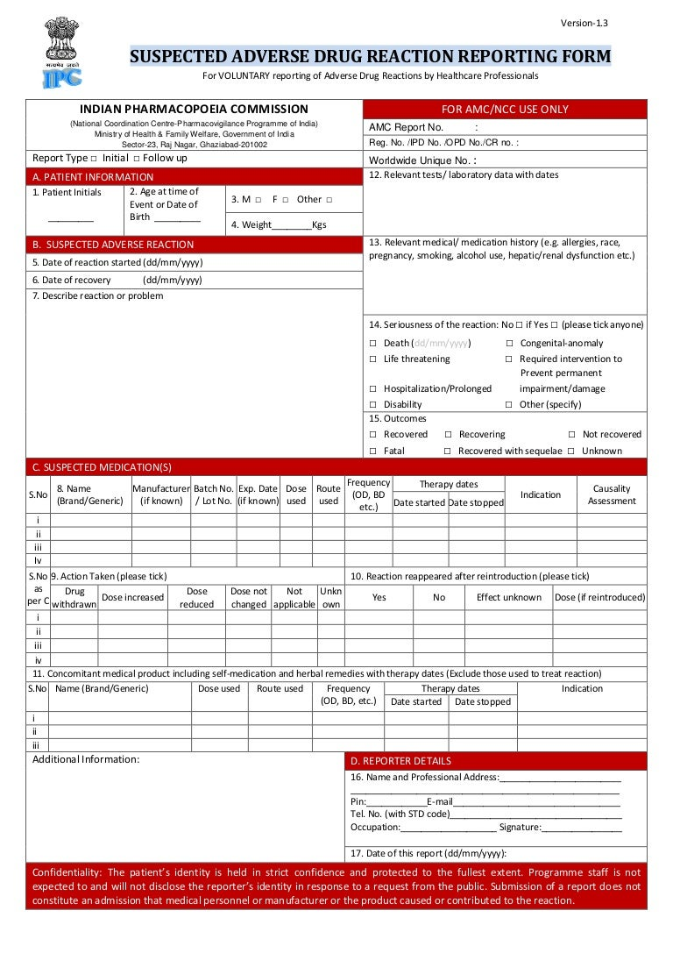

Slide 30
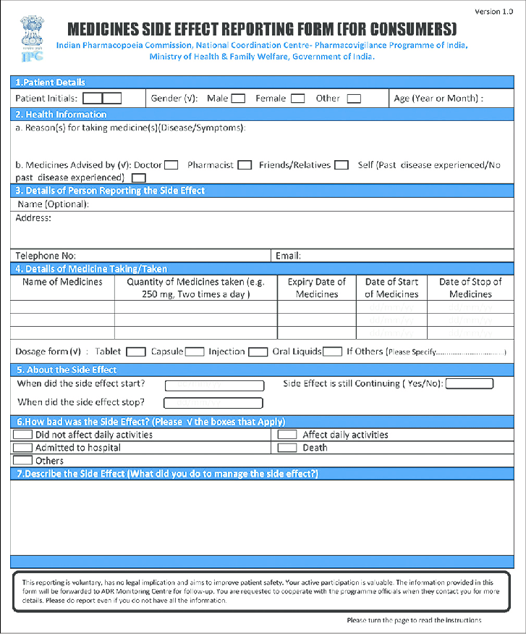

Slide 31
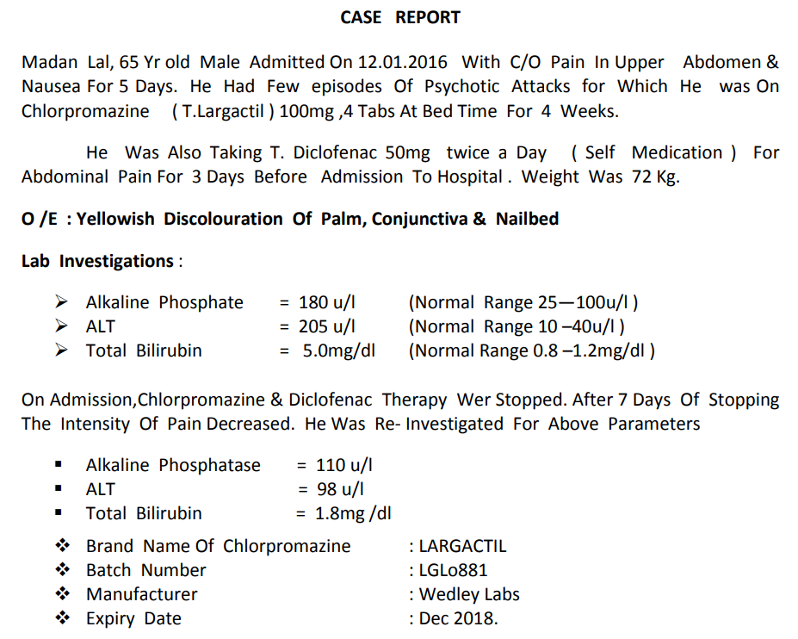

Slide 32
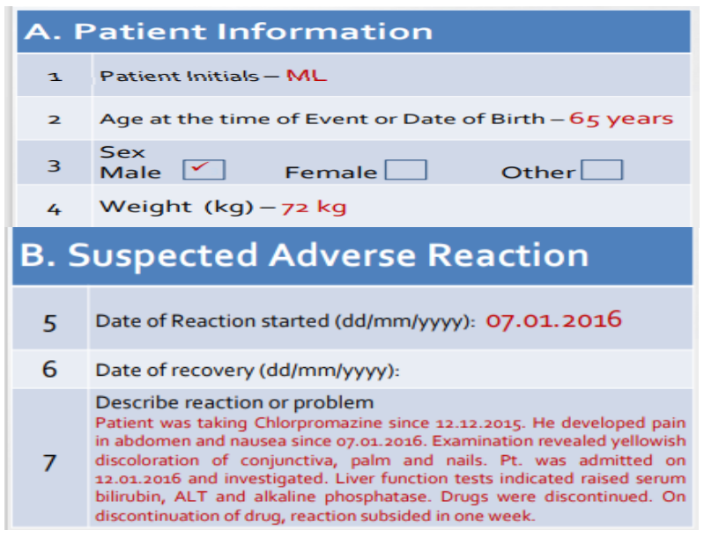

Slide 33
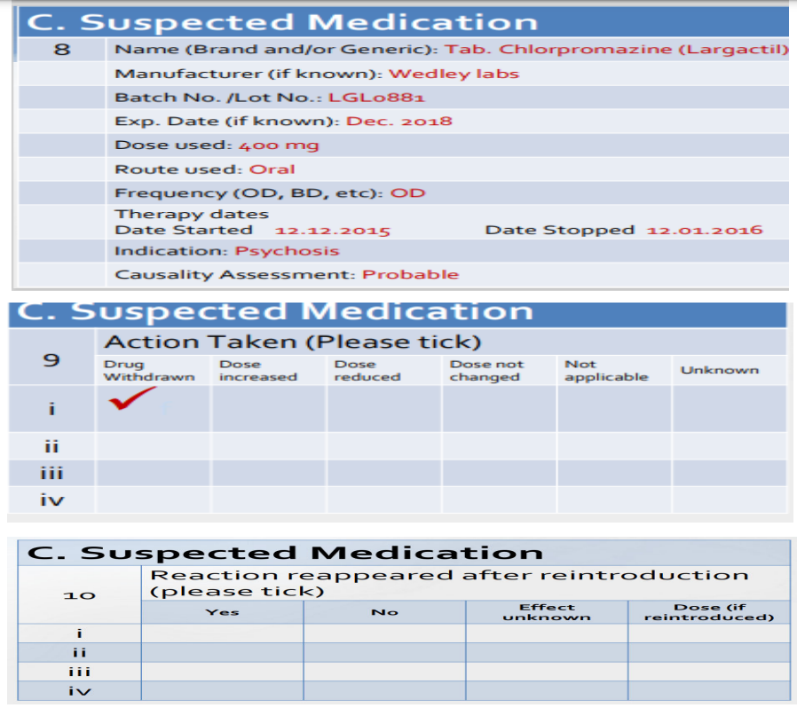

Slide 34
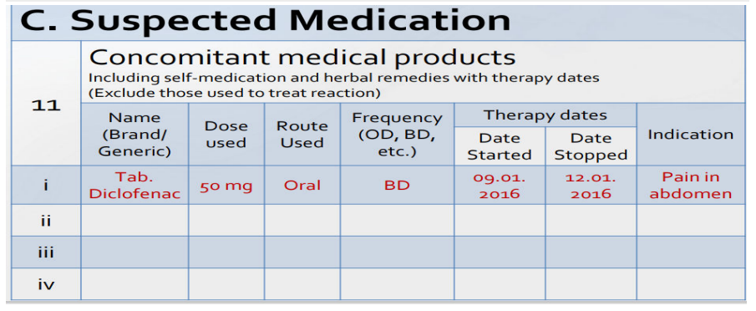

Slide 35
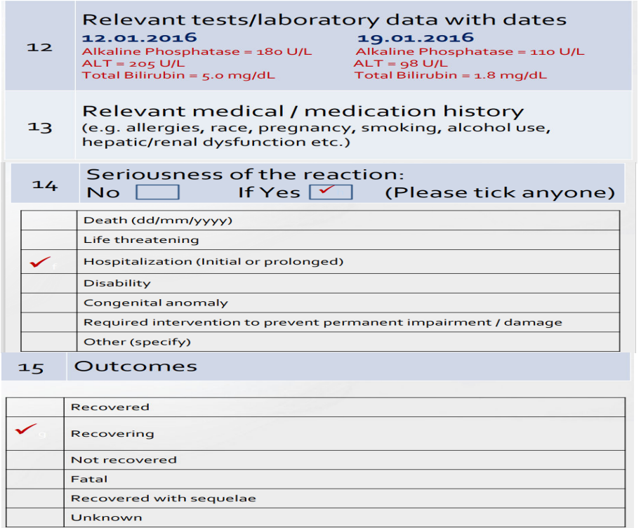

Slide 36
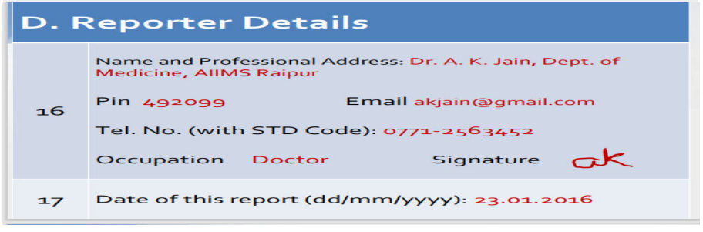

Slide 37
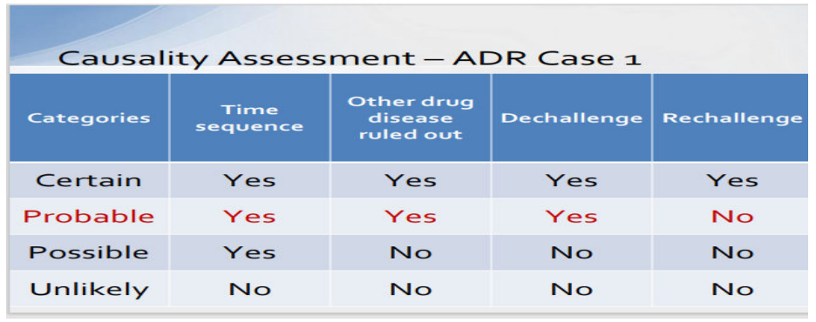

Slide 38
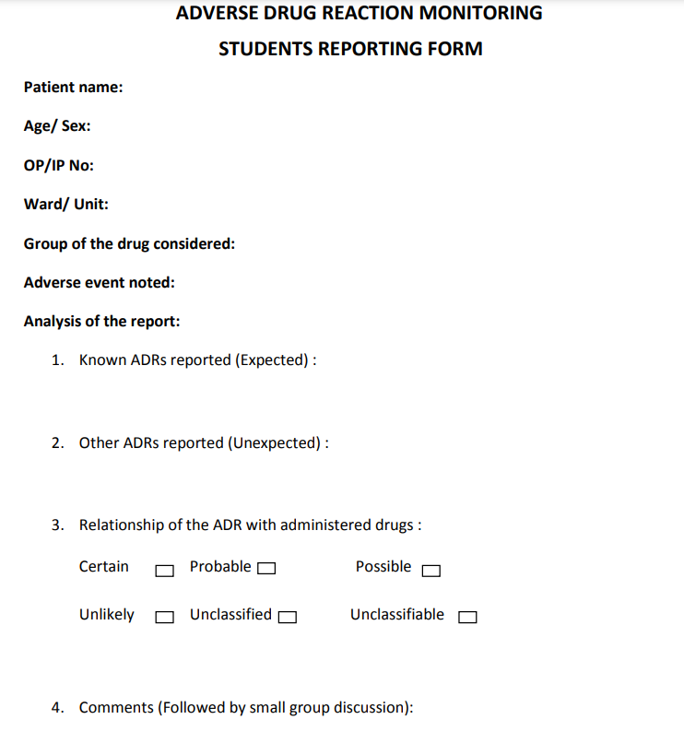

Slide 39
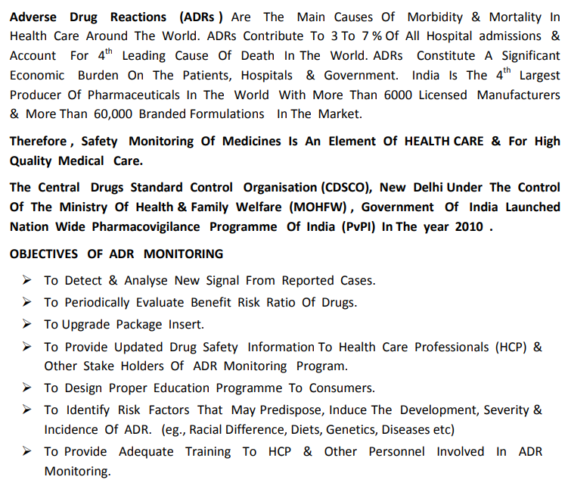

Slide 40
PHARMACOVIGILANCE

Slide 41
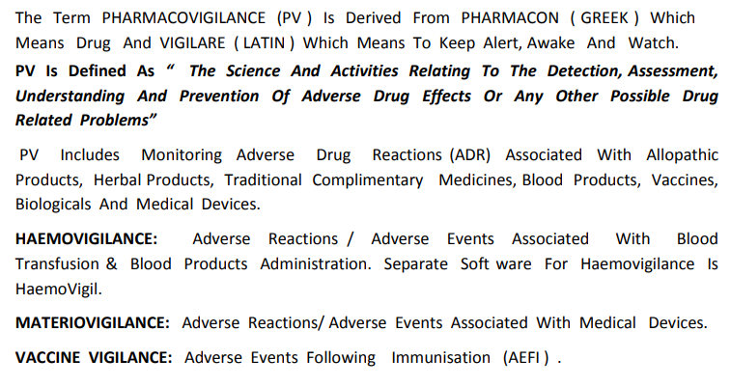

Slide 42
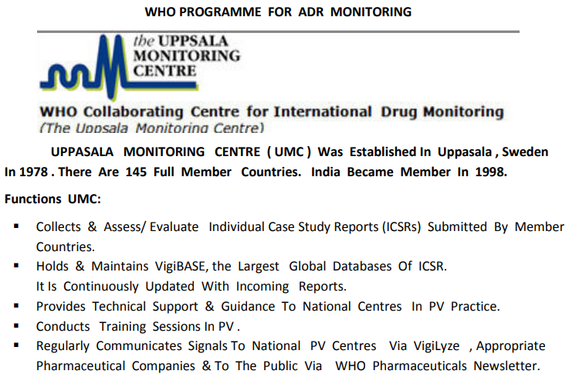

Slide 43
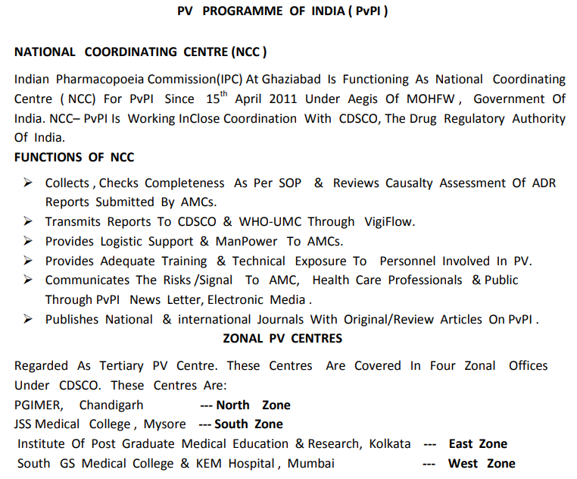

Slide 44
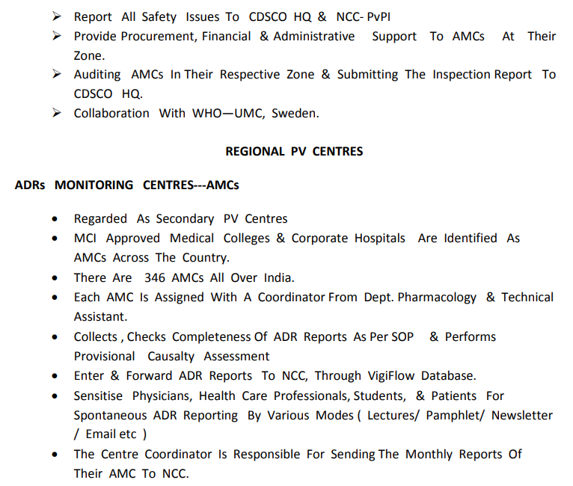

Slide 45
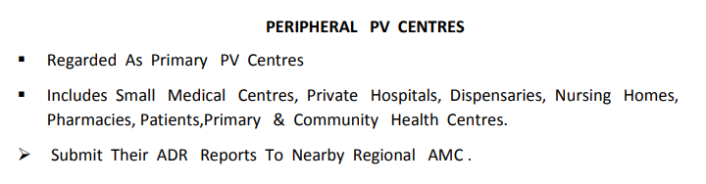

Slide 46
PH 1.6
18.05.2022
PHARMACOVIGILANCE
1.What is pharmacovigilance defined by WHO?
Pharmacovigilance has been defined by WHO as “The science and activities relating to the detection, assessment, understanding and prevention of adverse drug effects or any other possible drug related problems.”

Slide 47
2.Expand the full form of the following abbreviations:
WHO – World Health Organisation
UMC – Uppsala Monitoring Centre
MOHFW – Ministry of Health and Family Welfare
CDSCO – Central Drug Standard Control Organisation
AMC- Adverse drug Monitoring Centre
NCC – National Co-ordinating Centre
ICSR – Individual Case Safety Report
PvPI – Pharmacovigilance Programme of India

Slide 48
3.What do you understand by
Vigi flow
Vigi base
Vigi access
Vigi lyse
VIGI FLOW:
Vigi flow is a web based ICSR management system. It is individual country’s own natural PV database which supports collection, processing, analysis and sharing of ADR. The AMCs forward ICSR to NCC through Vigi flow. The NCC transmits ICSR to CDSCO & WHO-UMC through Viji flow.

Slide 49
VIGI BASE:
It is the WHO global database of ICSR. It contains ICSRs submitted by member countries of WHO Programme for International drug Monitoring System. It is the single largest drug safety data repository in the world. This database is maintained by UMC on behalf of WHO.
VIGI ACCESS:
This database allows as individual/or to browse and view data on suspected adverse drug reactions. All data contained herein is sourced from Vigi base.
VIGI LYSE:
Online resource that provides quick clear overview of Vigi base to National centre in member countries of WHO – PIDM (Programme of International Drug Monitoring).

Slide 50
THANK YOU ALL

